Slide 1
EE 521/ECE 582 – Analysis of Power systems
Class #15 – October 18, 2022
Dr. Noel N. Schulz
Edmund O. Schweitzer III Chair in
Power Apparatus and Systems
Chief Scientist Joint Appointment, PNNL
Co-Director, PNNL/WSU Advanced Grid Institute (AGI)
Washington State University Pullman
Noel.Schulz@wsu.edu EME 35
509-335-0980 (o) and 509-336-5522 (c)

Slide 2
Reminders
Office Hours on Zoom or in Pullman
Tuesday (EME 35 or Zoom) – 5-5:30 pm
Friday (EME 35 or Zoom) – 1:30-2:30 pm
Check in Meetings
Tuesday 4:30-5 pm
Wednesday 4-5 pm (during Office Hours)
Discussion Set #2

Slide 3
Discussion Set #2
Assignment #2 | Column A: Summarize (150 to 200 word summary of article) | Column B: List of three questions for class to answer? | Column C: Answer the Questions or Add to Discussions (Each response should be between 25 and 100 words)
See Canvas for Papers | Due: 10/18 | Due: 10/21 | Due: 10/28
Paper #1 | Liadi Akande | Noah Allison | All students in class should respond to three of these papers.
Paper #2 | Jacob Hastings | Sajjad Uddin Mahmud | All students in class should respond to three of these papers.
Paper #3 | Asif Iftekhar Omi | Md Samiul Islam Sagar | All students in class should respond to three of these papers.
Paper #4 | Sumanjali Pannala | Saeed Salimi Amiri | All students in class should respond to three of these papers.
Paper #5 | Md Mehedi Hasan Tanim | Leonardo Stingini | All students in class should respond to three of these papers.
Paper #6 | Hassan Yazdani | Ke Wang | All students in class should respond to three of these papers.
discussion_2_paper1_GPU-Based_Sparse_Power_Flow_Studies_With_Modified_Newtons_Method.pdf
discussion_2_paper2_The_continuation_power_flow_a_tool_for_steady_state_voltage_stability_analysis.pdf
discussion_2_paper3_Continuation_three phase_power_flow_a_tool_for_voltage_stability_analysis_of_unbalanced_three-phase_power_systems.pdf
discussion_2_paper_4_Grid_Influences_From_Reactive_Power_Flow_of_Photovoltaic_Inverters_With_a_Power_Factor_Specification_of_One.pdf
discussion_2_paper_5_Intergrid_A_Future_Electronic_Energy_Network.pdf
Discussion_2_paper_6_Successive-Intersection-Approximation-Based_Power_Flow_Method_for_Integrated_Transmission_and_Distribution_Networks.pdf

Slide 4
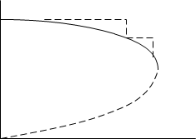
Dr. Bose’s notes
Continuation Power Flow
PV curve
Nose curve
$$\underline{K}=\underline{f}(\underline{δ},\underline{V})$$
$$\left|V\right|$$
Let
$$λ\underline{K}−\underline{f}\left(\underline{δ},\underline{V}\right)=\underline{0}$$
where $\underline{K}$ is loading profile $\left|\begin{matrix}\underline{P} \\ \underline{Q}\end{matrix}\right|$
$$F\left(λ, \underline{δ},\underline{V}\right)=\underline{0}$$
λ is loading parameter
P
$$\frac{∂F}{∂δ}dδ+\frac{∂F}{∂V}dV+\frac{∂F}{∂λ}dλ=0$$
λ is an extra unknown, add one more equ $\left|\begin{matrix}\begin{matrix}0 & … & \underline{+}1\end{matrix} & \begin{matrix}⋯ & 0\end{matrix}\end{matrix}\right|\left|\begin{matrix}\underline{dδ} \\ \underline{dV} \\ dλ\end{matrix}\right|=1$
$$e_{k}$$
When dλ + ve, load increasing
dλ - ve, load decreasing
dV - ve, voltage decreasing

Slide 5
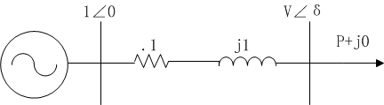
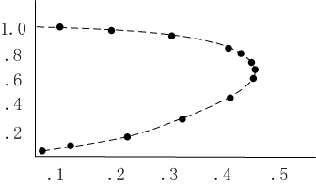
Dr. Bose’s notes
2-Bus Example
$$σ$$ | $$δ$$ | V | $$λ$$
.1 | -.1017 | .9847 | .1
.1 | -.2105 | .9570 | .2
.1 | -.3354 | .9113 | .3
.1 | -.5050 | .8268 | .4

Slide 6
What is the solution for the Continuation Power Flow?

Slide 7
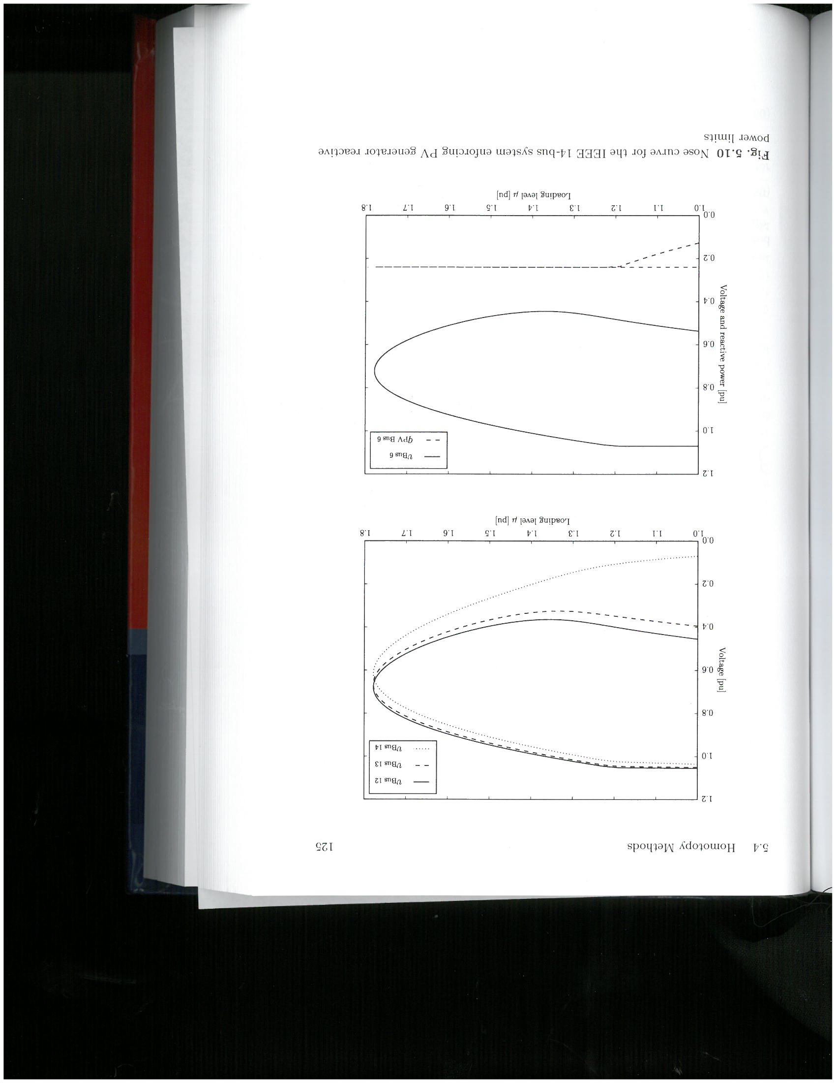
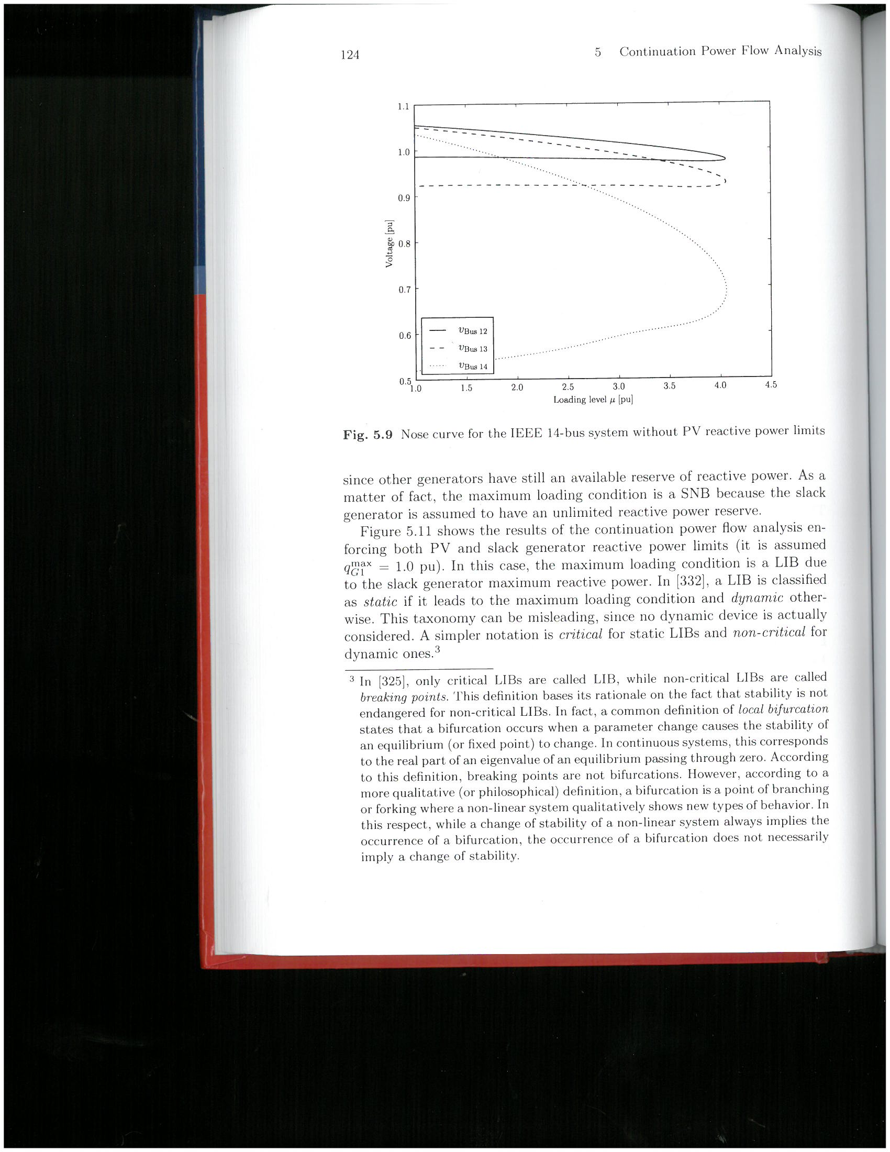
Federico Milano, Power System Modelling and Scripting, Springer, 2010

Slide 8
Program #2 – Sparse Matrices Program
Full Newton Raphson -- Take the Jacobian Matrix from Program #1 (with taps) and solve the problem using Sparse Matrix Techniques
Fast Decoupled Power Flow – Use Sparse Matrix Techniques for B’ and B’’ and solve. Use Scheme 0 to solve Fast Decoupled Power Flow
Extra Credit -- Fast Decoupled Power Flow – Use Sparse Matrix Techniques for B’ and B’’ and solve. Use Scheme 0 to solve Fast Decoupled Power Flow
**** Do not use the SEARCH function as that is not an acceptable method ****
ON HOLD FOR NOW

Slide 9
Program #3 – Continuation Power Flow
Develop the Continuation Power Flow algorithm to determine the P-V curves for all the required buses in the IEEE 14 bus test case with taps. Do not worry about Q limits for this problem.

Slide 10
Chapter 6
Optimization

Slide 11
What is optimization? Why optimize?

Slide 12
Objective
The basic objective of any optimization method is to find the values of the system state variables and/or parameters that minimize some cost function of the system.
Some examples:
Minimize:
• the error between a set of measured and calculated data,
• active power losses,
• the weight of a set of components that comprise the system,
• particulate output (emissions),
• system energy, or
• the distance between actual and desired operating points

Slide 13
Formulation
Minimize
Subject to
where x is the vector of system states and u is the vector of system parameters.
Power flow equations
Transmission line limits, Q_{gen} limits, etc
PQ bus voltage magnitudes and phase
PV bus voltage magnitudes, P_{gen}

Slide 14
What is state estimation? Why do we care about state estimation?

Slide 15
What types of measurements do we have on the power grid?
How good are measurements?
How do they help?
- How can they hurt?

Slide 16
Least Squares Estimation (LSE)
State Estimation is the process of estimating unknown states from measured quantities.
In many systems, more measurements are made than are necessary to uniquely determine the operating point.
Conversely, not all of the states may be available for measurement.
State estimation gives the “best estimate” of the state of the system in spite of uncertain, redundant, and/or conflicting measurements.

Slide 17
Let z be the set of measured quantities
The measured values of z may not equal the true values of z^{true} due to
measurement errors,
missing data, or
intentional misdirection (hacking)
We’d like to
Identify bad data
Minimize the error between the true and measured values
States of the system

Slide 18
“squared error”
Minimize
Minimizing the square of the error is desired to negate any effects of sign differences between the measured and true values.
Minimize

Slide 19
Minimize
Take derivative and set equal to zero:
Solving for x:
Solve using LU factorization (or other linear solver)
Analytic solution

Slide 20
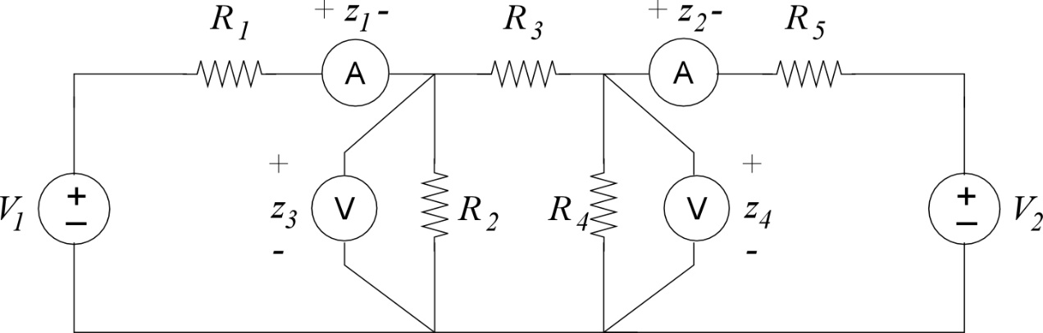
Find the node voltages
V₁ and V₂
Circuit equations

Slide 21
Yielding:
Least squares estimation:
Analytic solution

Slide 22
Solving for voltages:
Finding the error:
How do we know if this is a reasonable error?

Slide 23
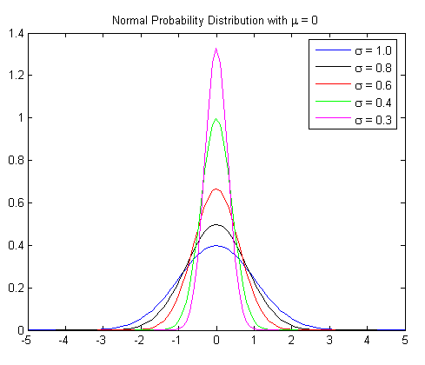
Weighted Least Squares Estimation (WLSE)
Suppose we have more confidence in certain types of measurements:
Certain sensors have been more recently calibrated
Some types of sensors tend to be more accurate (smaller standard deviation)
We’d like to apply more weight to measurements in which there is greater confidence

Slide 24
Introduce a weighting factor:
In matrix form:

Slide 25
Let
The currents are weighted more heavily than the voltages
Decreased error in current
Resulting in
with
original

Slide 26
A plausible weighting matrix that reflects the level of confidence in each measurement set is the inverse of the covariance matrix W = R⁻¹.
Measurements that come from instruments with good consistency (small variance) will carry greater weight than measurements that come from less accurate instruments (high variance).

Slide 27
Announcements
Reading Chapter 6
Remember to start on Discussion Set #2
Check-in meetings this week
Start working on Program #3 when done with #1
Next week
I’ll teach from Vancouver classroom on Tuesday
Office Hours from Vancouver and via zoom on Tuesday & Wednesday
Class on next Thursday (10/27) via Zoom or Vancouver classroom (no class in Pullman classroom)

